Slide 1
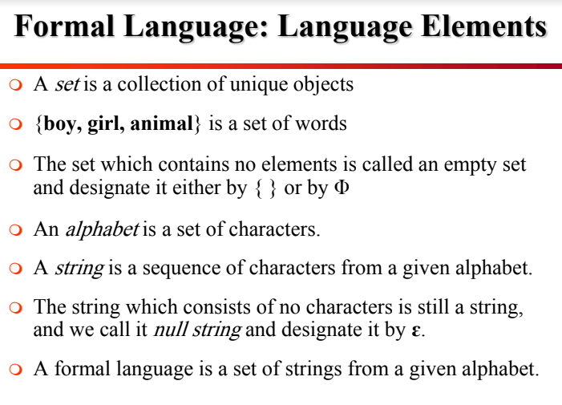
Compiler
Lexical analysis

Slide 2
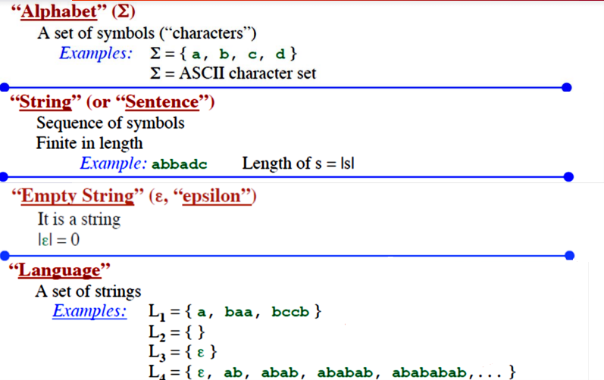
Compiler
Lexical analysis
Formal language

Slide 3
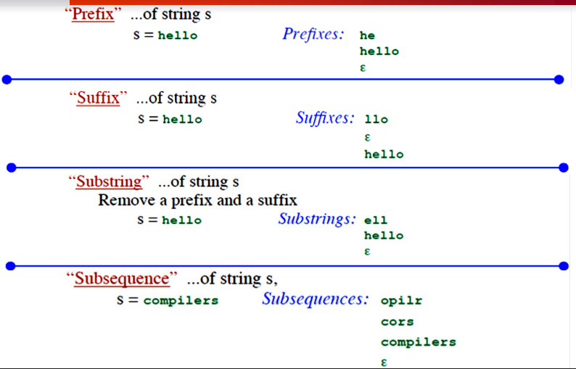
Compiler
Lexical analysis
Formal language

Slide 4
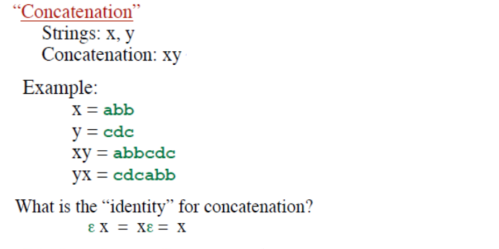
Compiler
Lexical analysis
Formal language

Slide 5
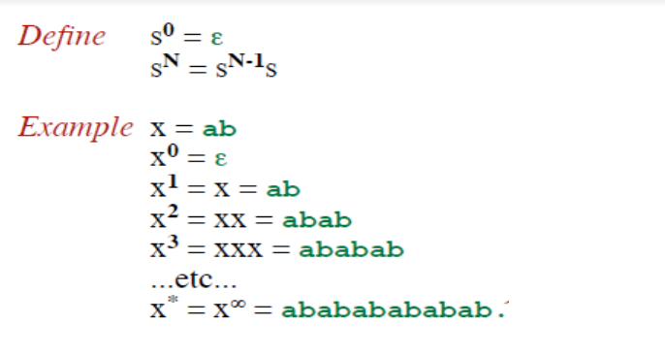
Compiler
Lexical analysis
Formal language

Slide 6
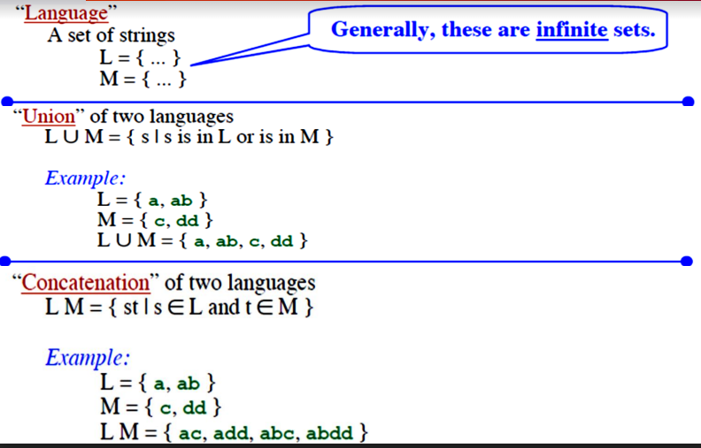
Compiler
Lexical analysis
Formal language

Slide 7
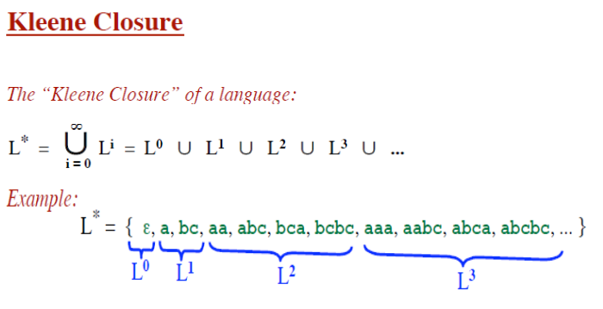
Compiler
Lexical analysis
Formal language

Slide 8
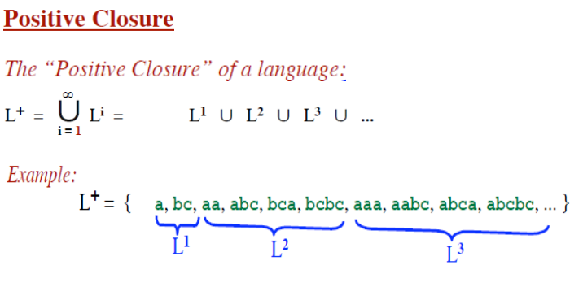
Compiler
Lexical analysis
Formal language

